Slide 1



Vertical Slice Architecture
Jimmy Bogard
@jbogard
github.com/jbogard
jimmybogard.com

Slide 2


Slide 3
Inmates and asylums
ASPX
4 screens
Basic workflow
Role-based security
20K LoC
2 solutions, 12 projects
Code-Behind
ServiceProxy
WCF Service Proxy
WCF Service
BAL
DAL
Stored Procedure

Slide 4
Traditional n-tier
UI Layer
Business Logic Layer
Data Access Layer
Database

Slide 5
“DDD”-style n-tier
UI Layer
Services
Domain
Repository

Slide 6
Organizing by layer
Person.cs
PersonController.cs
PersonService.cs
PersonRepository.cs

Slide 7
PersonController
StudentController
Index
Edit
Create
Search
Enroll
Create
PersonService
StudentService
Index
Edit
Create
Search
Enroll
Create
PersonRepository
StudentRepository
Find
Get
Save
Find
Get
Save

Slide 8
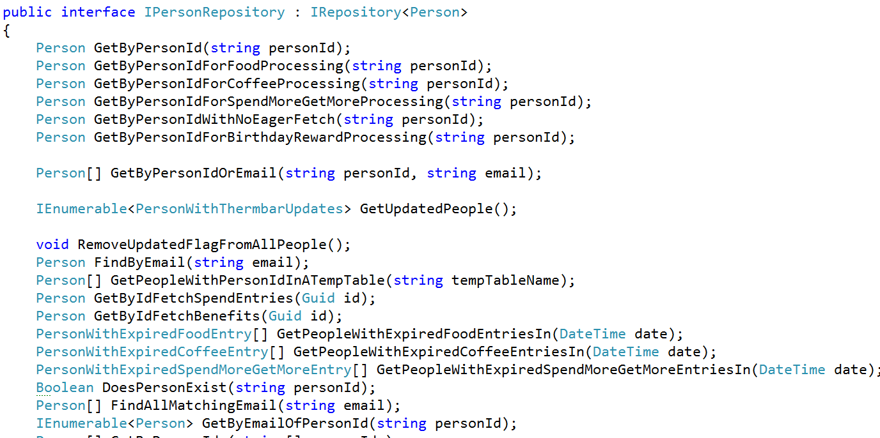
Inmates blew up the asylum

Slide 9
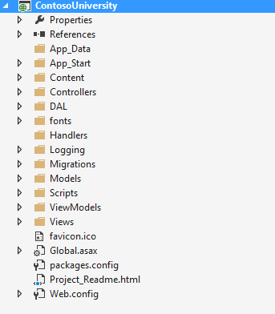
Areas of change

Slide 10
Axes of change
View Unapproved Invoices
Approve Invoice
Reject Invoice
UI Layer
Domain Objects
Repository
Database

Slide 11
Vertical Slice Architecture Model and organize application architecture around axes of change, vertical slices

Slide 12
Vertical Slices

Slide 13
Move code to single place

Slide 14
Move service methods to classes
Invoice Service
void Approve()
ApproveInvoice {}
void Reject()
RejectInvoice {}
void Flag()
FlagInvoice {}

Slide 15
Modeling requests
Input
Request Handler
Output

Slide 16
Request/Response with MediatR
IRequest<T>
IRequest
Handler<T>
T
Task<TResponse> Handle(
TRequest request) {
}

Slide 17
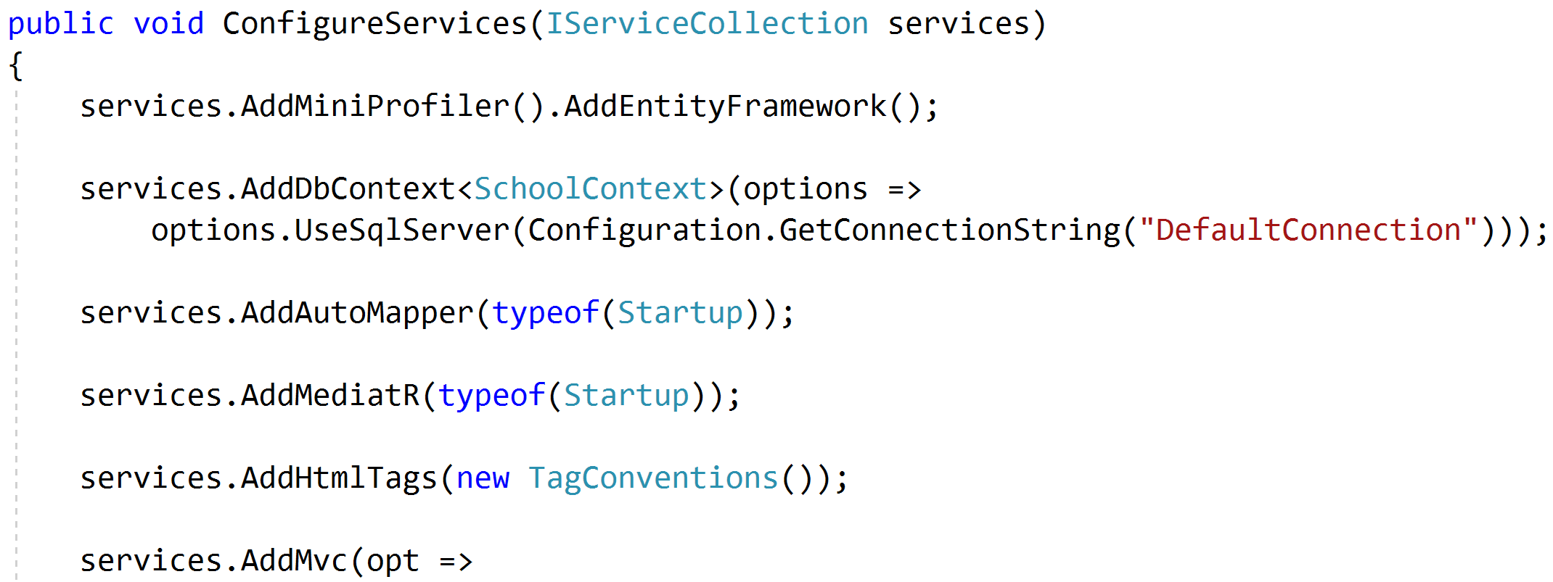
Registering MediatR

Slide 18
Commands and Queries
Web App
GET
Query
Handler
Response
Query
POST
Command
Handler
Response
Command

Slide 19
One model in, one model out
Query
Handler
Response
Command
Handler
Response

Slide 20
Complete encapsulation
Request
Response

Slide 21
Modeling Queries
Query
Handler
Response

Slide 22
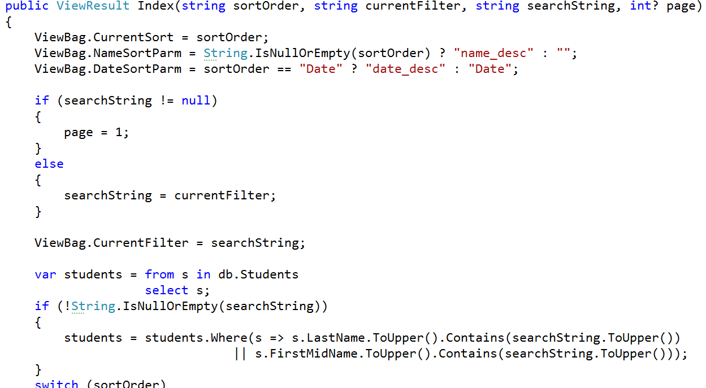
Modeling Queries

Slide 23
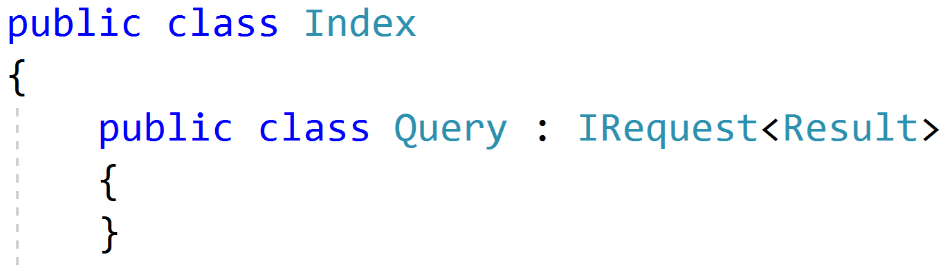
Simple Queries

Slide 24
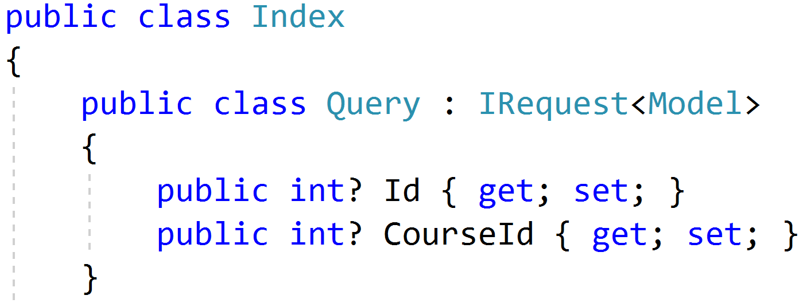
Parameterized Queries

Slide 25
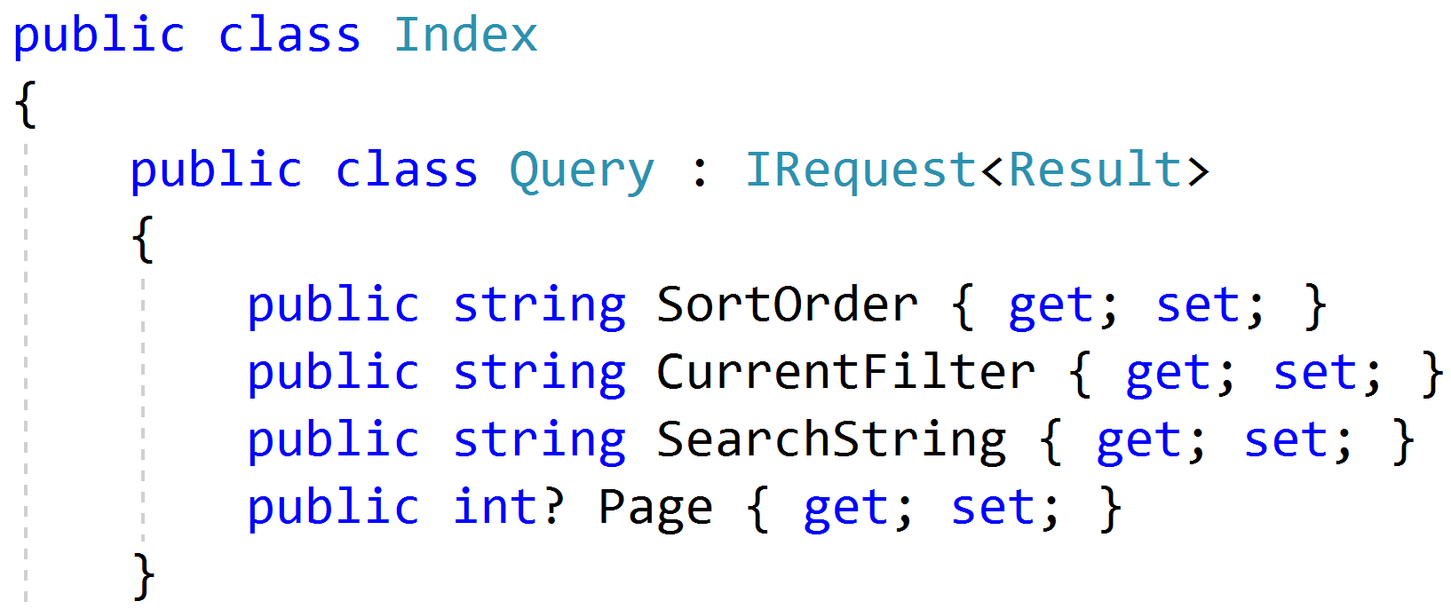
Paging/Sorting/Filtering

Slide 26
Modeling Responses
Query
Handler
Response
View

Slide 27
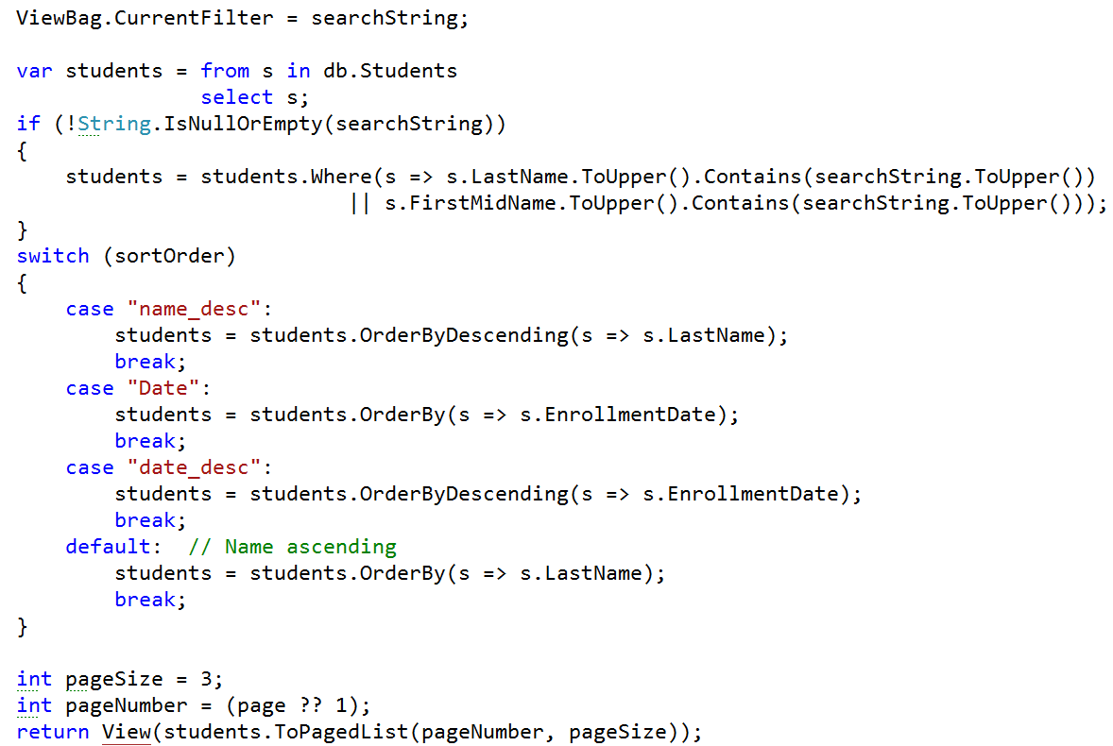
Modeling outputs

Slide 28
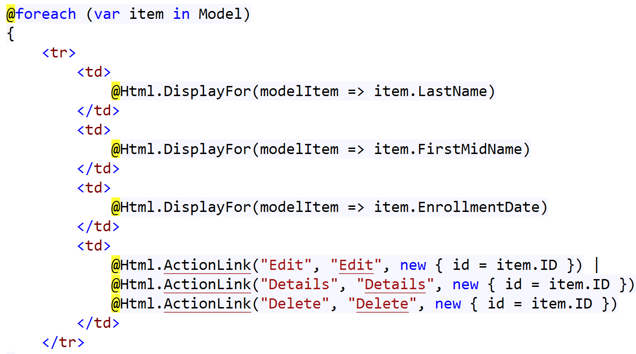
Modeling outputs

Slide 29
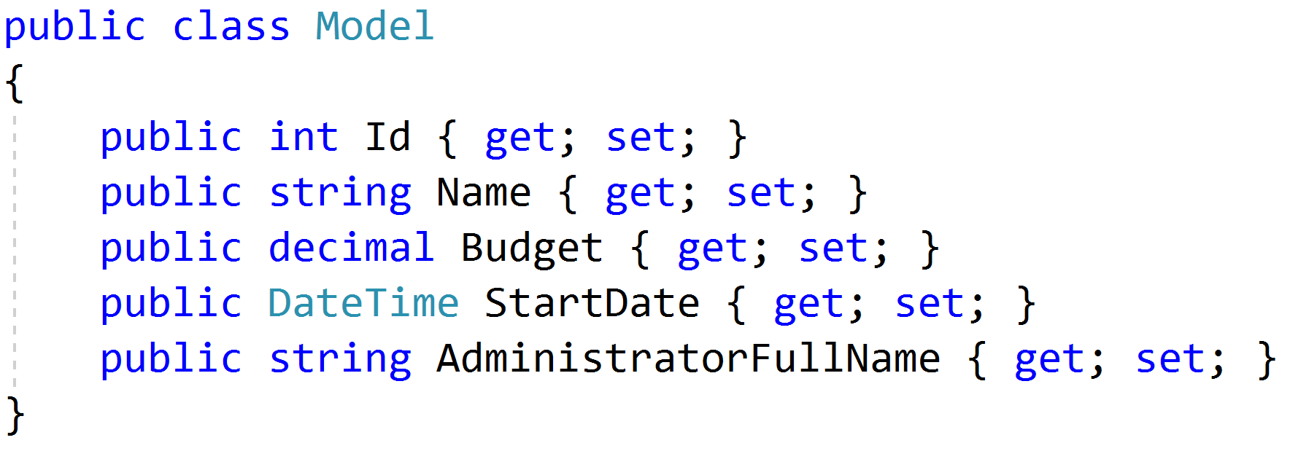
Simple Response

Slide 30
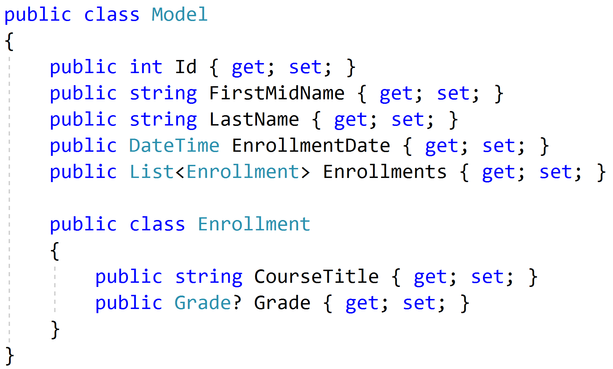
Complex Response

Slide 31
Modeling Query Handlers
Query
Handler
Response

Slide 32
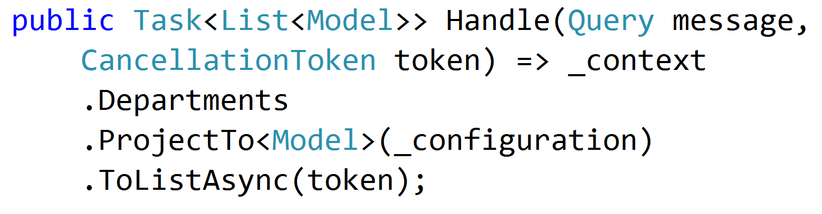
Simple AutoMapper Projections

Slide 33
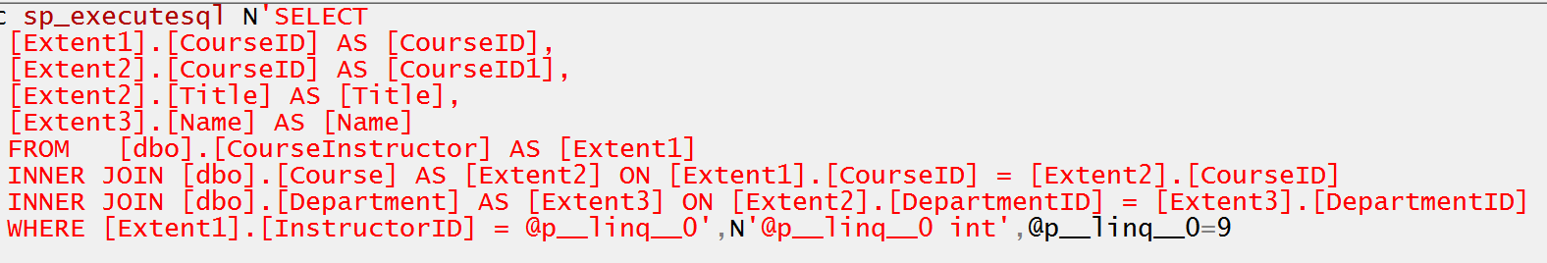
Projecting Query Result

Slide 34
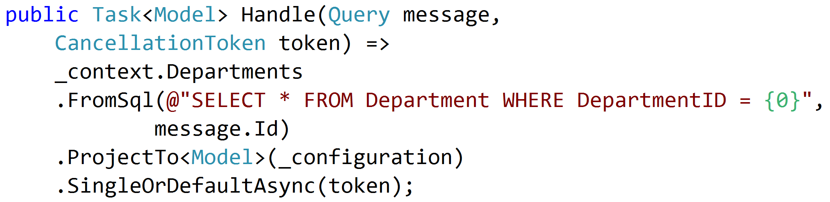
SQL Projections

Slide 35
Encapsulated Logic
Query
ORM
Response
Query
MicroORM
Response
Query
HttpClient
Response
Query
MeatGrinder
Response

Slide 36
Duplicate Query Logic
Query
Handler
Response
Common
Query
Handler
Response
Common

Slide 37
Refactor
Query
Handler
Response
Class?
Function?
Extension Method?
Common
Query
Handler
Response

Slide 38
Modeling Commands
Command
Handler
Response

Slide 39
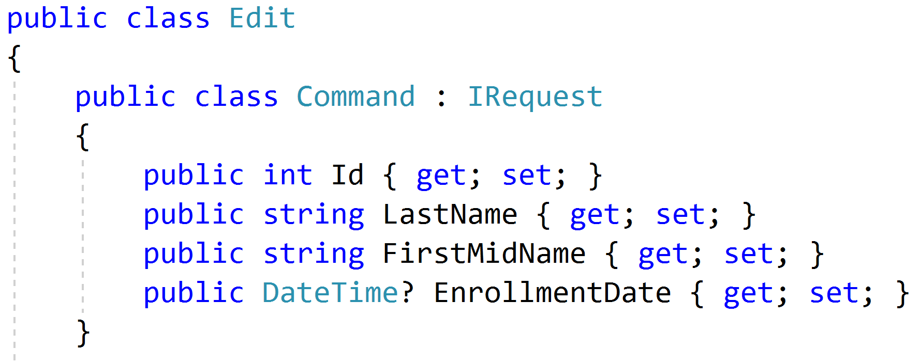
Simple Commands

Slide 40
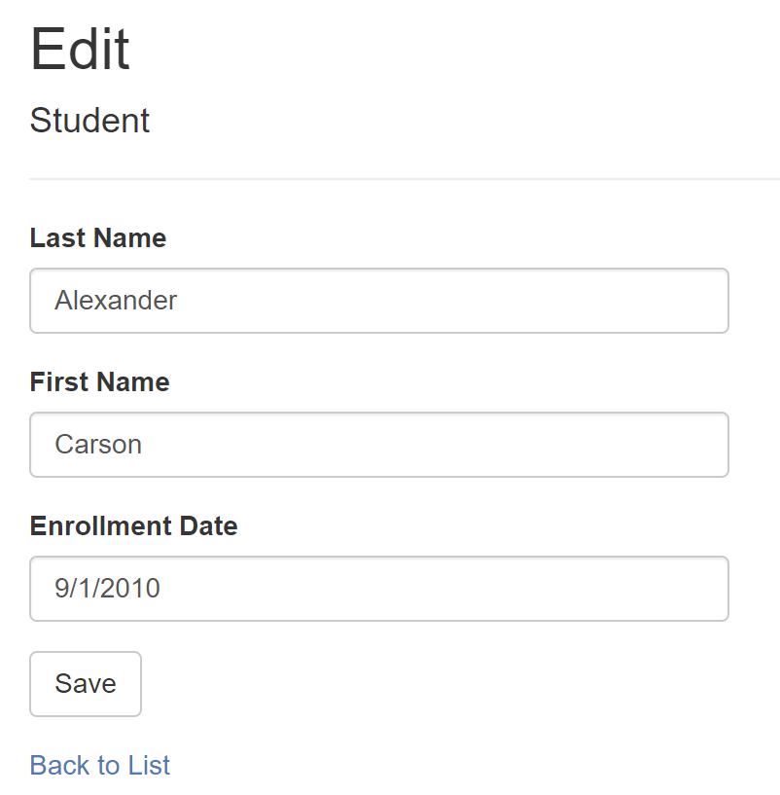
Model-Bound Types

Slide 41
Task-Based UIs
Transfer
Student Details
Request
Handler
Response
Transfer
Correct
Schedule
…
…
…
…
…
…
…
Correct
Request
Handler
Response
Schedule
Request
Handler
Response

Slide 42
Modeling Command Responses
Command
Handler
Response

Slide 43
Void Response
Command
Handler
IRequest

Slide 44
Command Result Response
Command
Handler
T
IRequest<T>

Slide 45
Success/Fail
Command
Handler
true/
false
IRequest<bool>

Slide 46
Creation
Create
Handler
Id
IRequest<Guid>
302 Found
/orders/081bcba7-89ff-4a41-af90-ded095160b99

Slide 47
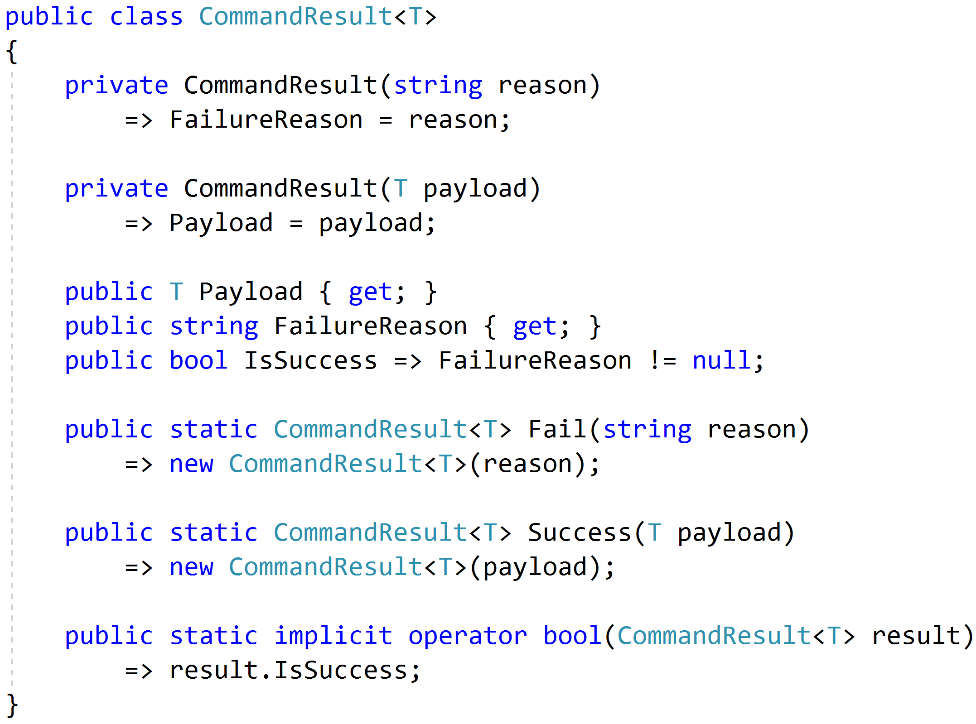
Complex Response

Slide 48
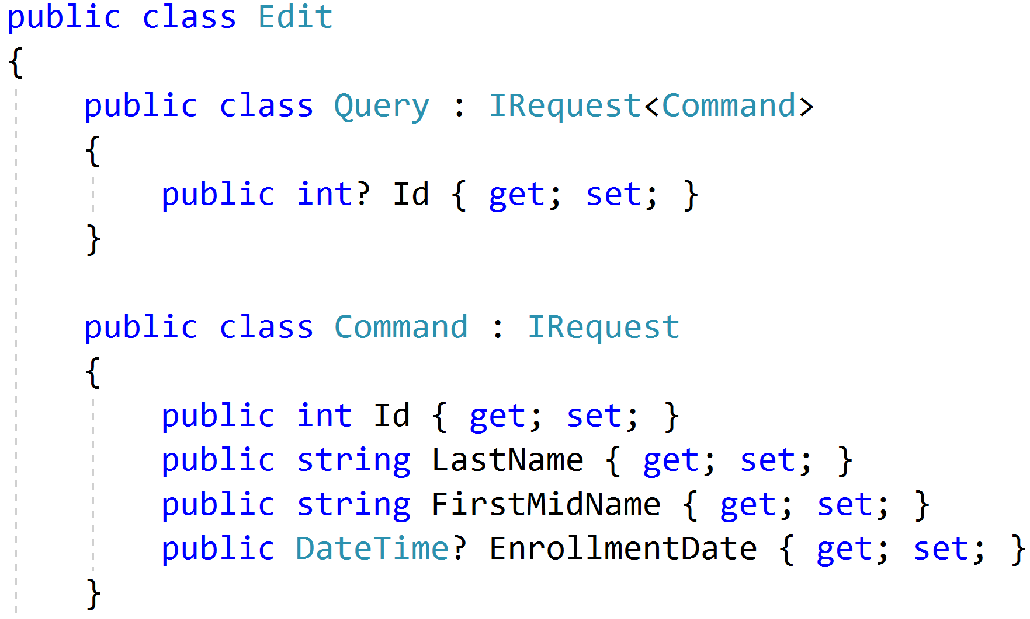
Command/Query Duality

Slide 49
Command Handlers
Command
Handler
Response

Slide 50
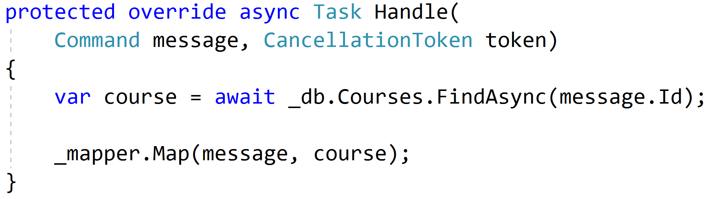
Procedural Beginnings

Slide 51
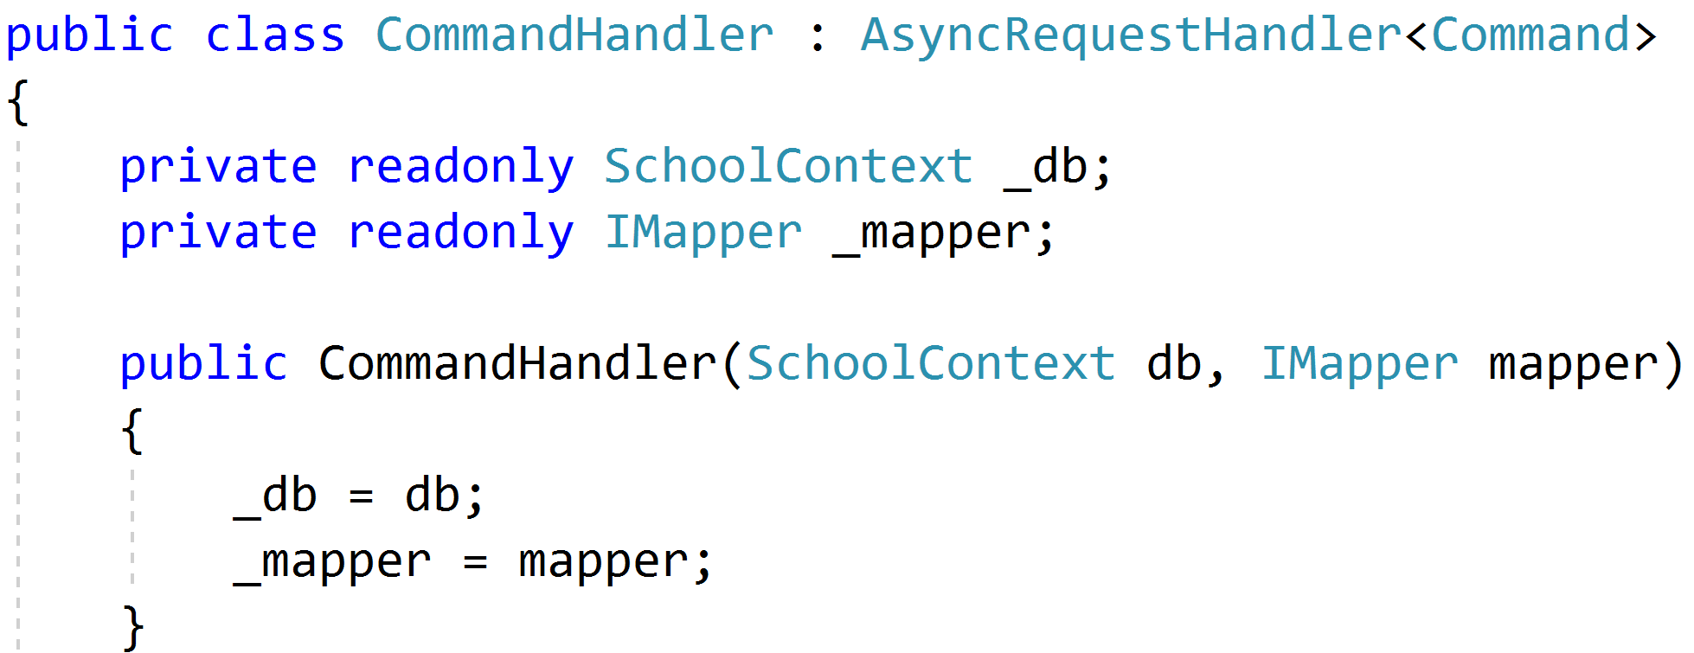
DI with no abstractions

Slide 52
Complexity?

Slide 53
Don't Panic!

Slide 54
Red
Green
Refactor

Slide 55

Code Smells
Large Class
Extract Class
Extract Subclass
Extract Interface
Replace Method
with Method Object
Compose Method
Extract Method
Move Method
Long Method

Slide 56

Behavioral Smells
Combinatorial Explosion
Conditional Complexity
Feature Envy
Inappropriate Intimacy
Duplicated Code

Slide 57
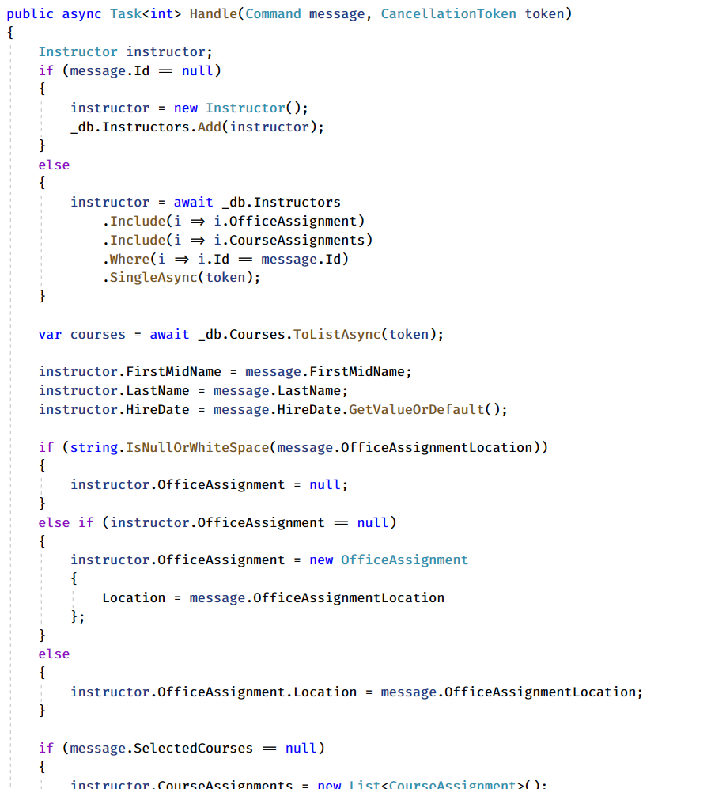
Large Method!
Request
Handler
Domain
Response

Slide 58
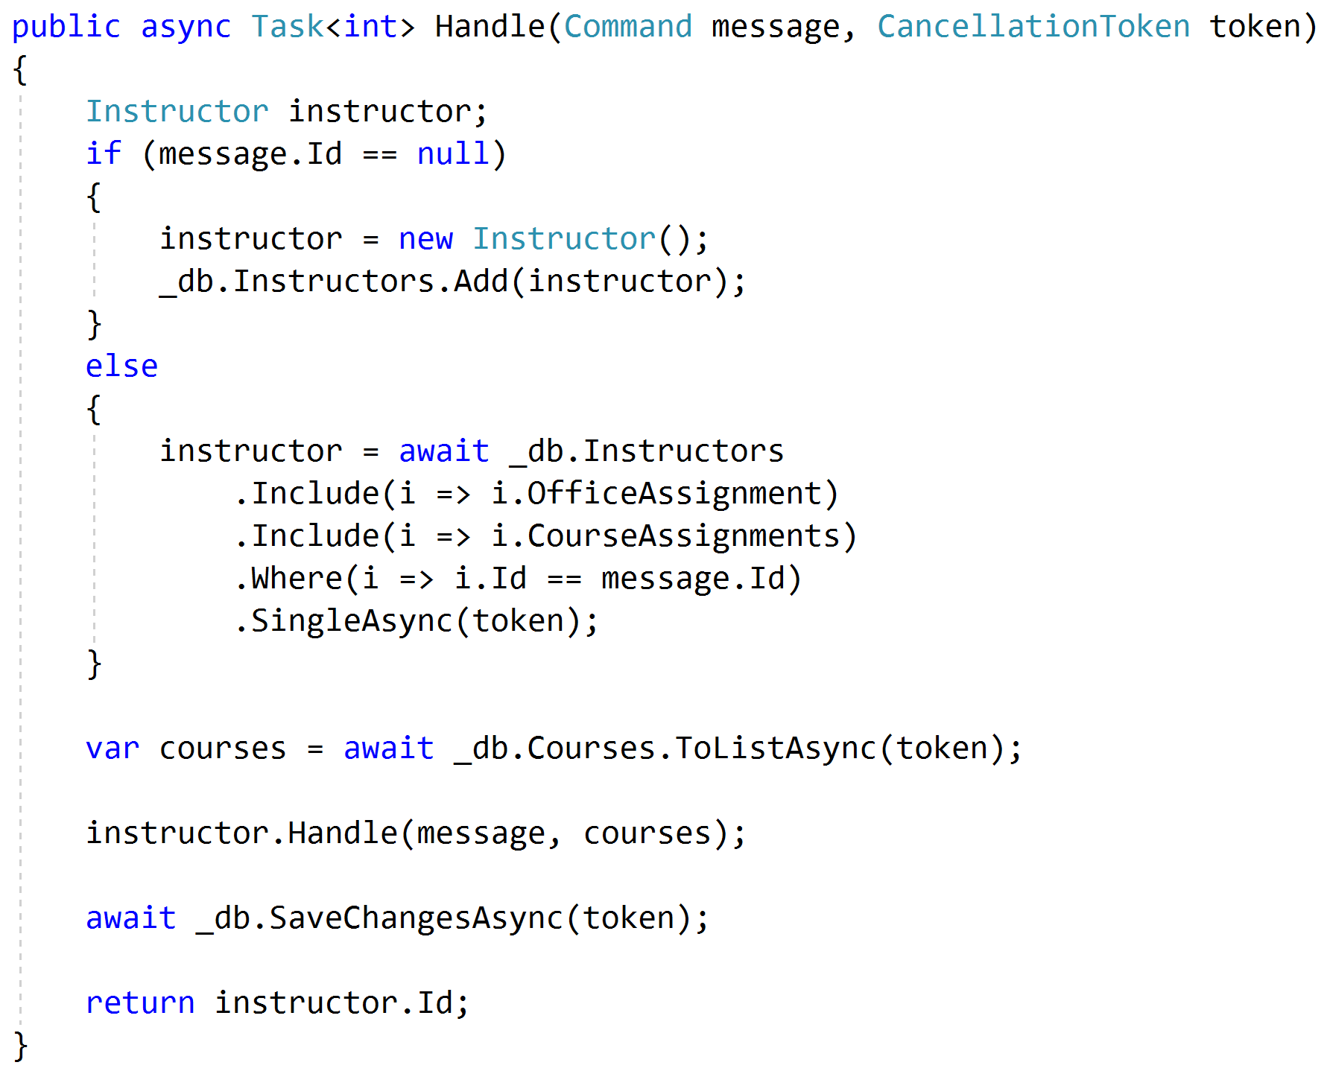
Push Behavior Down
Request
Handler
Domain
Response

Slide 59
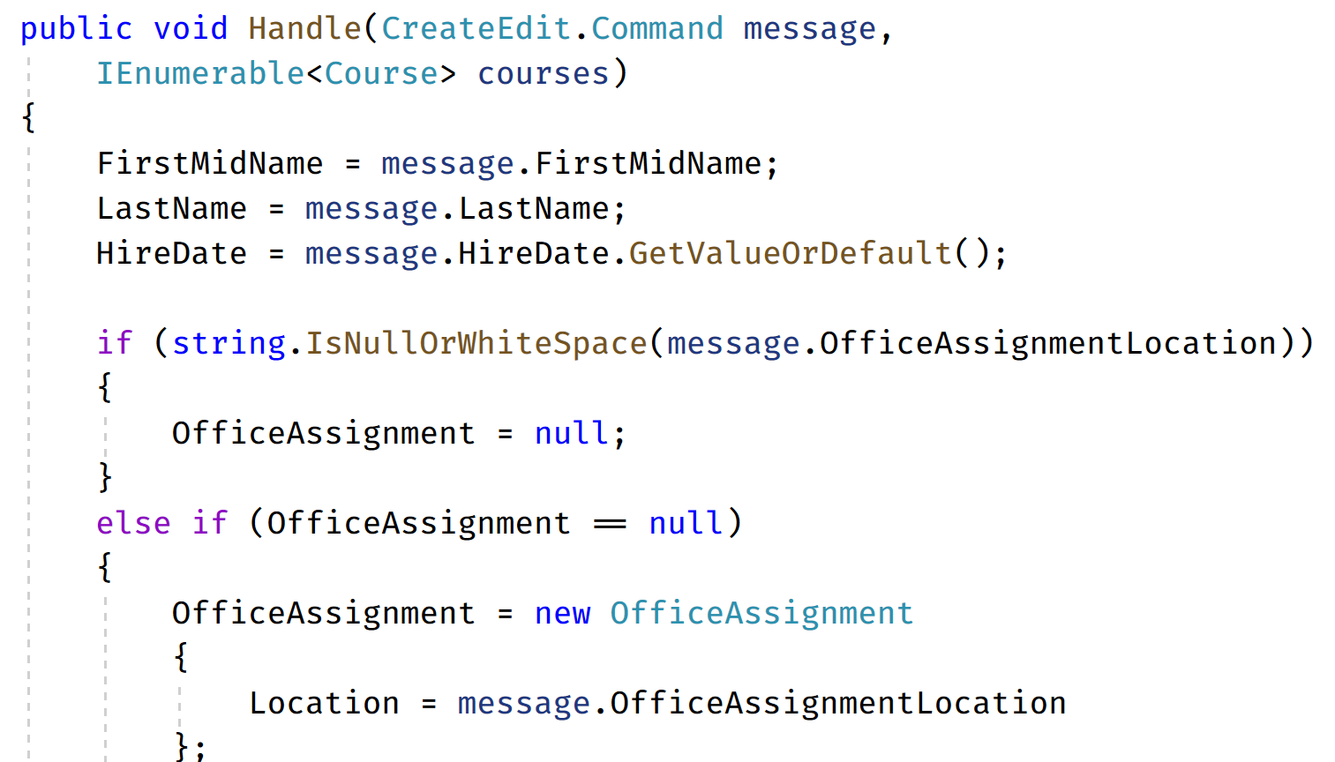
Code Smells (again)
Request
Handler
Domain
Response

Slide 60
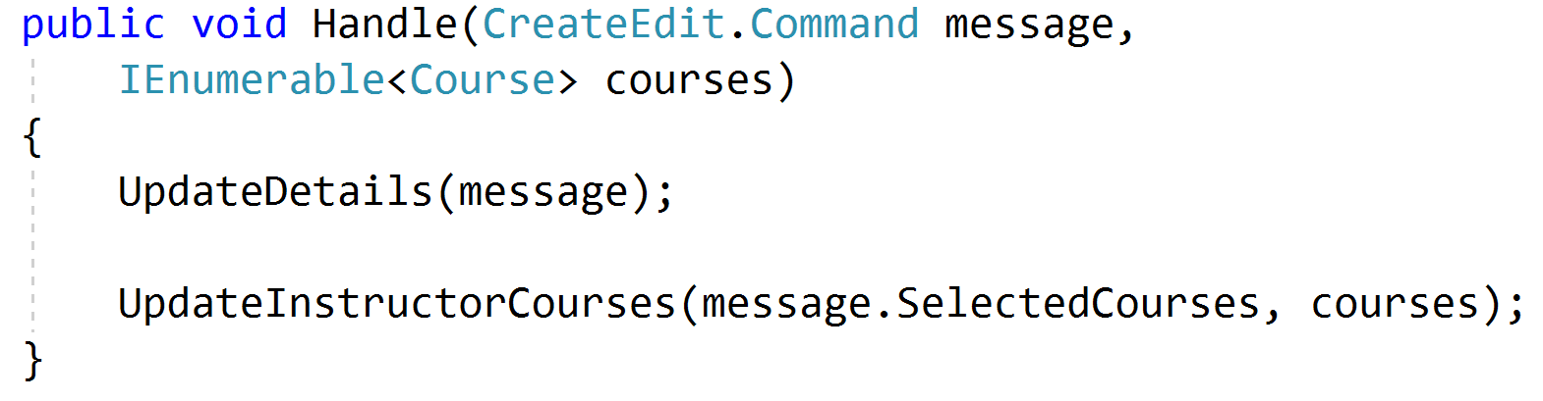
Refactored Toward Encapsulated Domain
Request
Handler
Domain
Response

Slide 61
Validation?

Slide 62
Validation Scopes
Command Validation
Domain Model
Request Validation
Request
Database
External Models

Slide 63
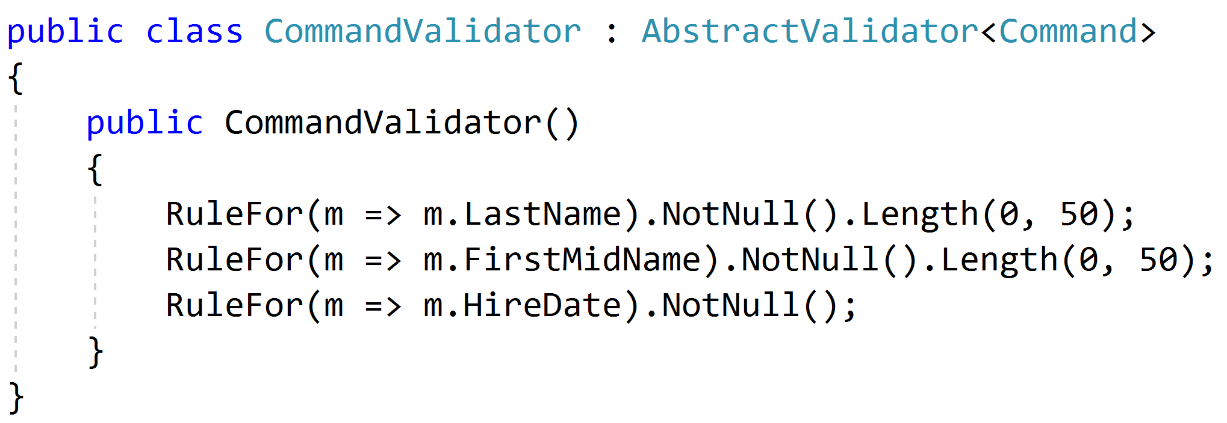
Request Validation

Slide 64
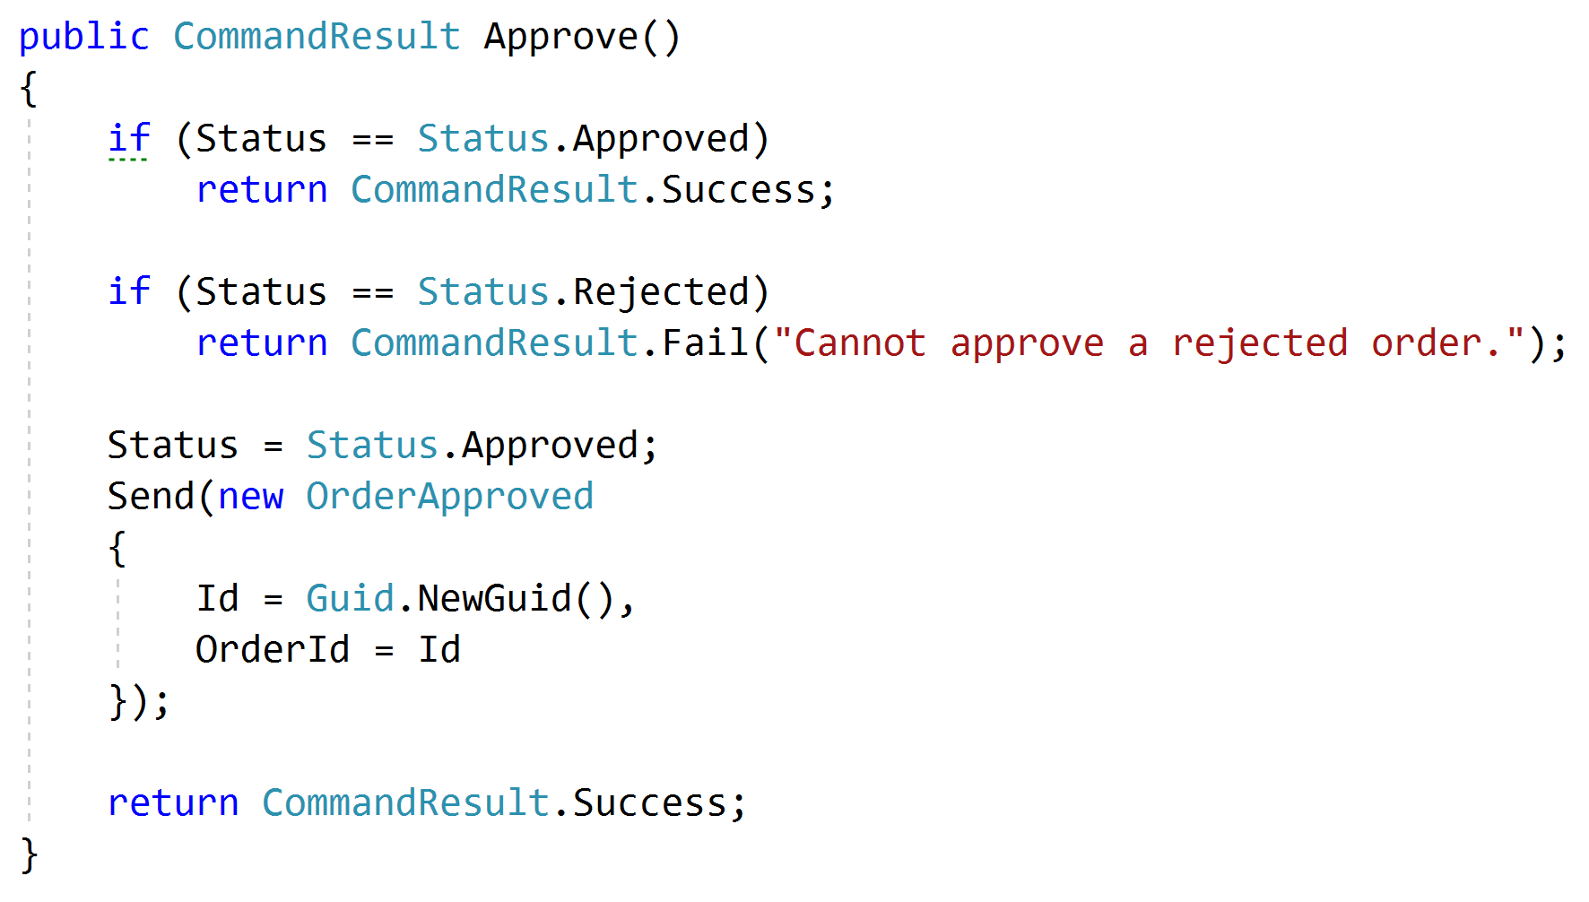
Domain Validation
Request
Handler
Domain + Validation
Response

Slide 65
Representations
Query
Handler
Response
????

Slide 66
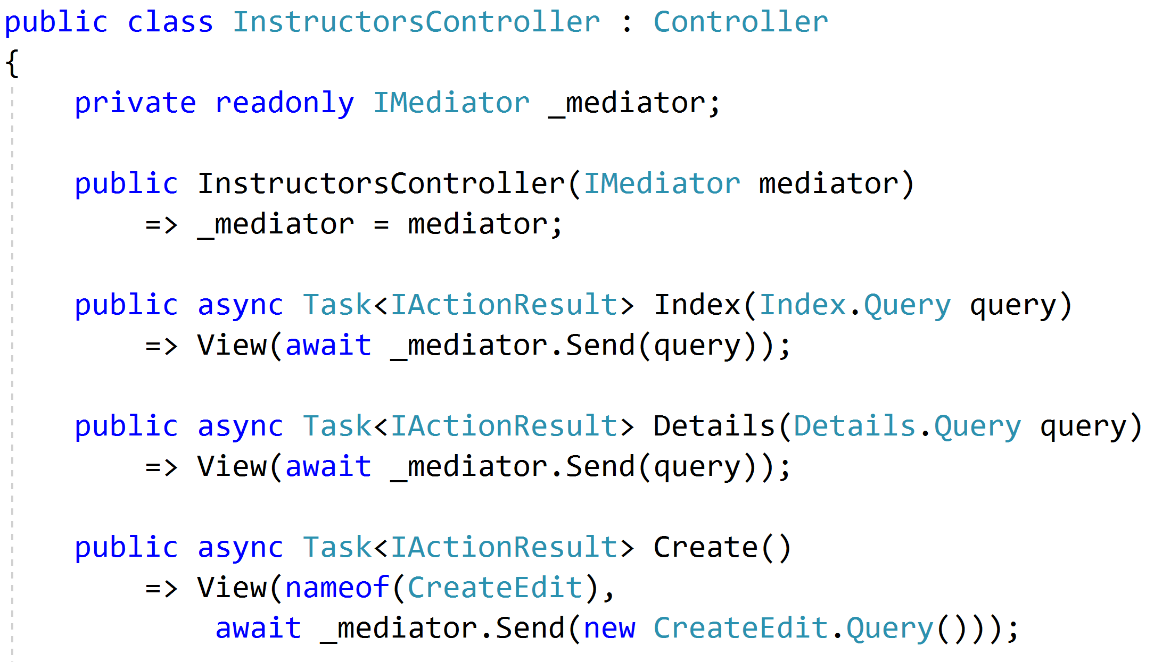
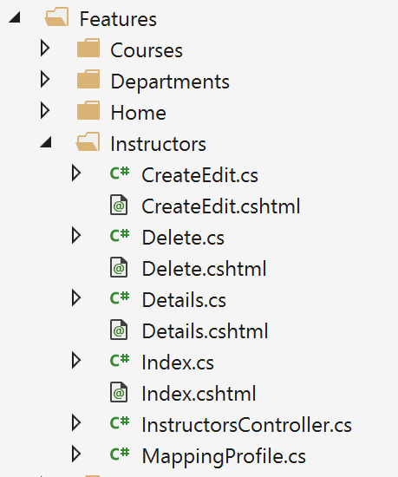
Controllers as routes

Slide 67
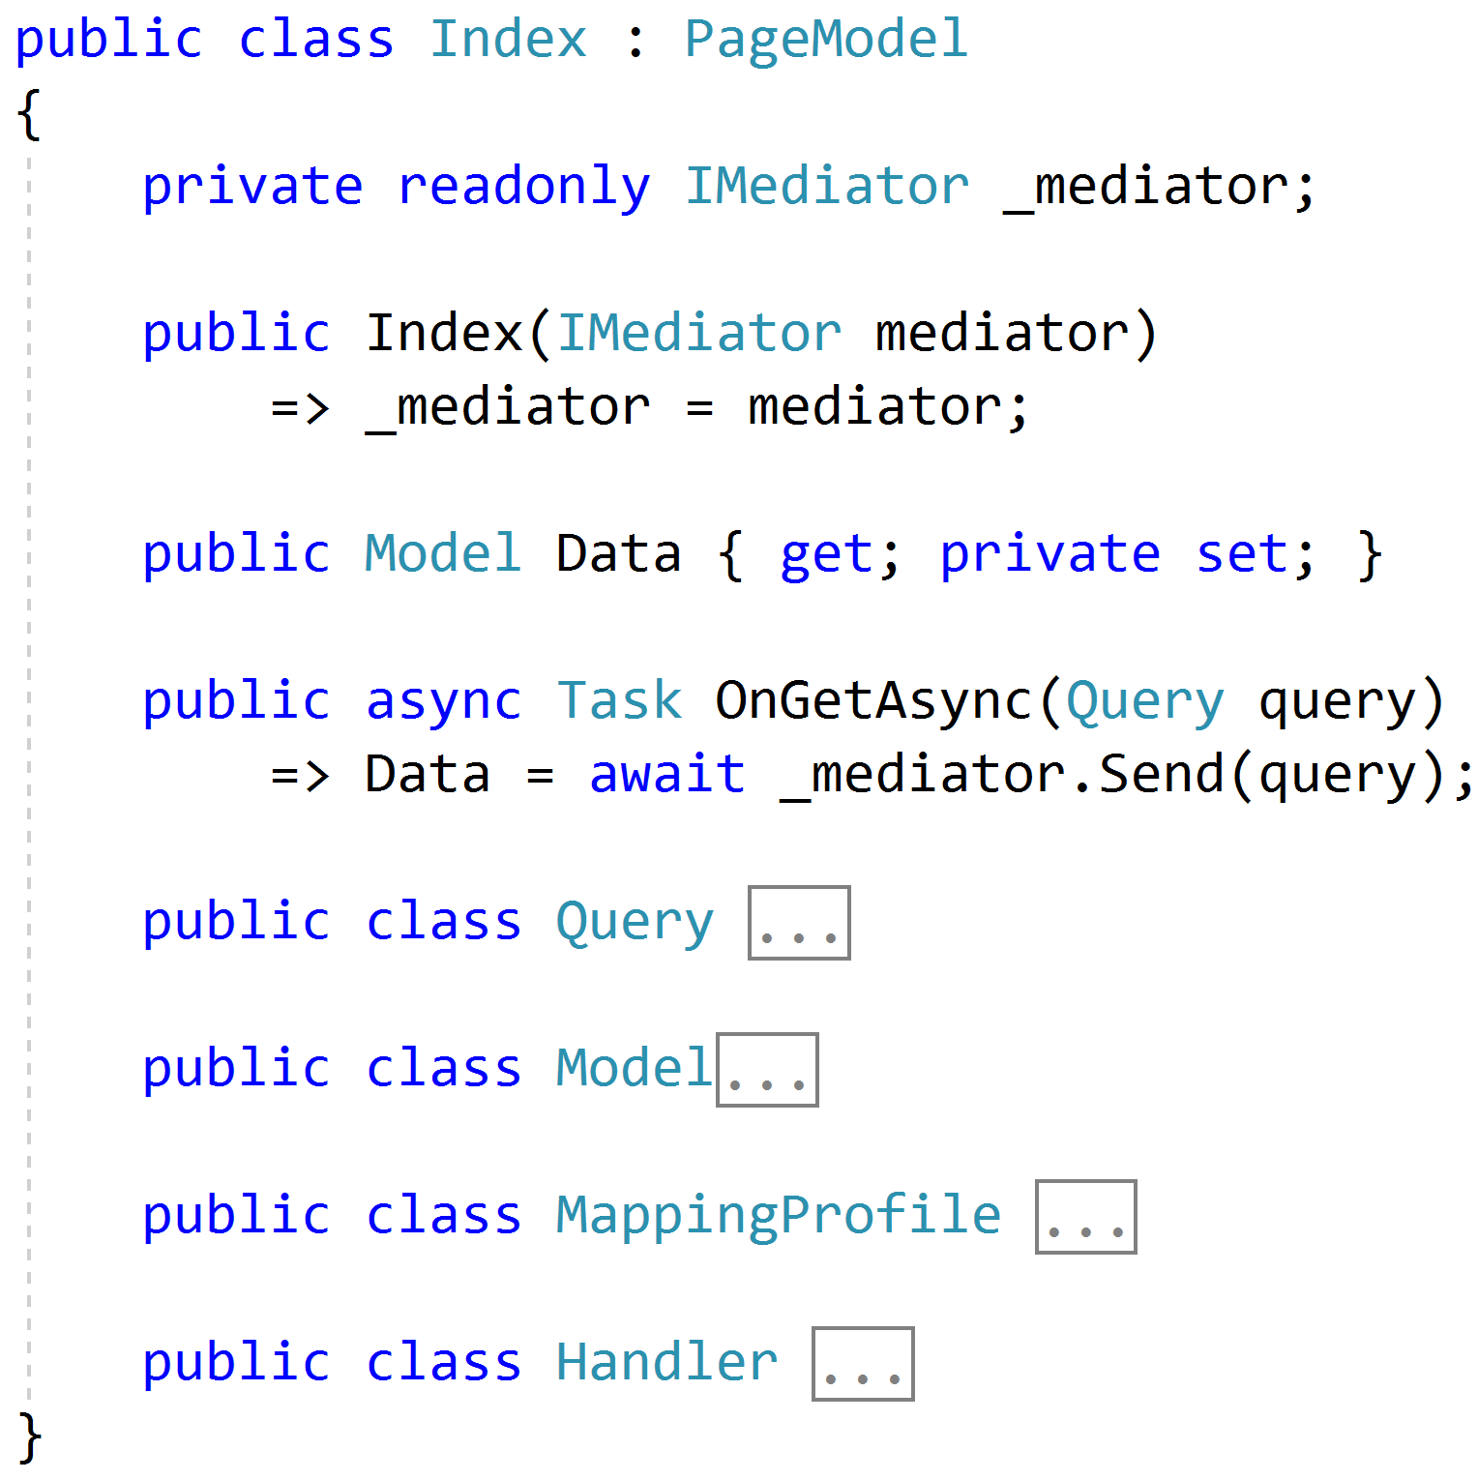
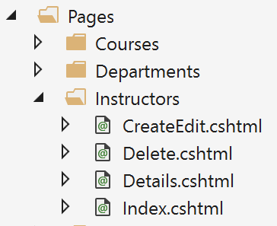
Razor Pages

Slide 68
Web APIs
/order/approve
Handler
/order/reject
Handler
Order json
/order/hold
Handler
/order/cancel
Handler
SPA

Slide 69
Cross-Cutting Concerns
Duplication
Request
Handler
Response

Slide 70
Pipeline Behavior (Decorator)
Pipeline Behavior
Request
Handler
Response

Slide 71
Stackable Decorators
Pipeline Behavior
Pipeline Behavior
Pipeline Behavior
Handler

Slide 72
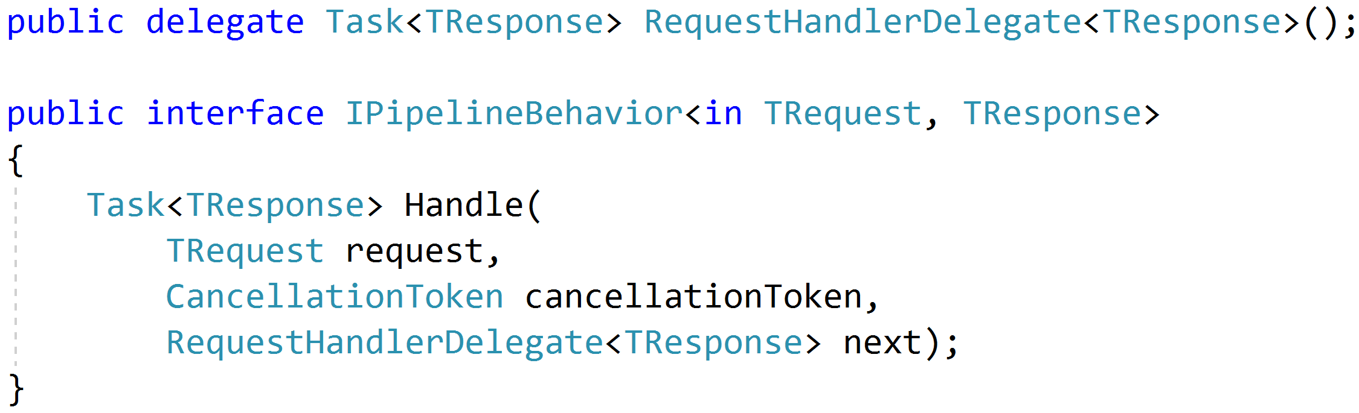
Think: Action Filters

Slide 73
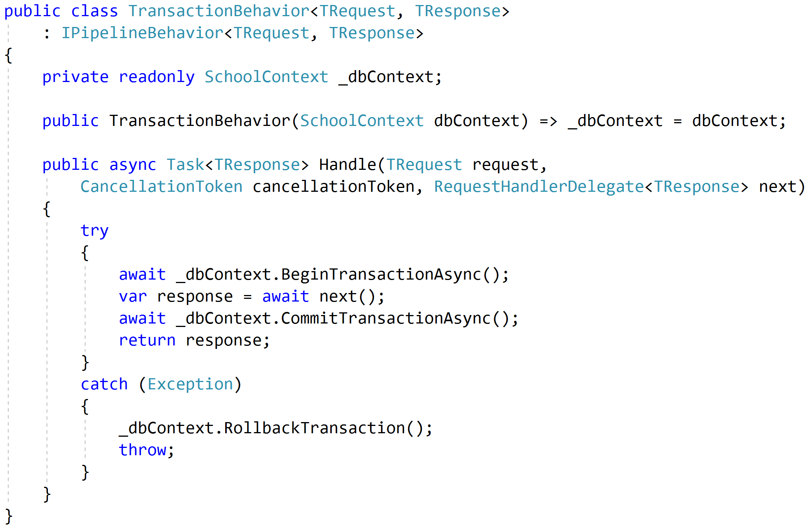
Transactions

Slide 74
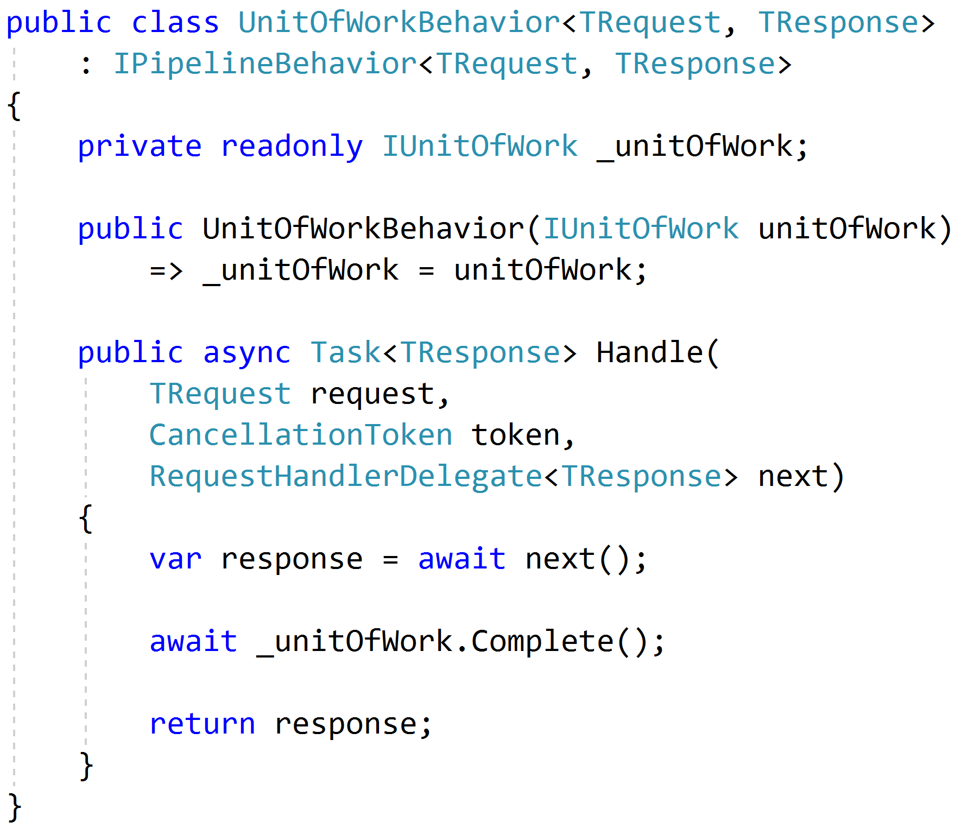
Unit of Work

Slide 75
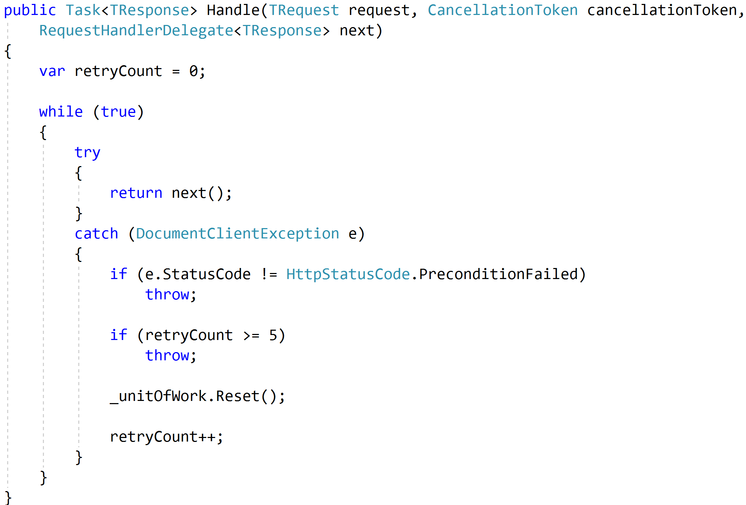
Concurrency and Retries

Slide 76
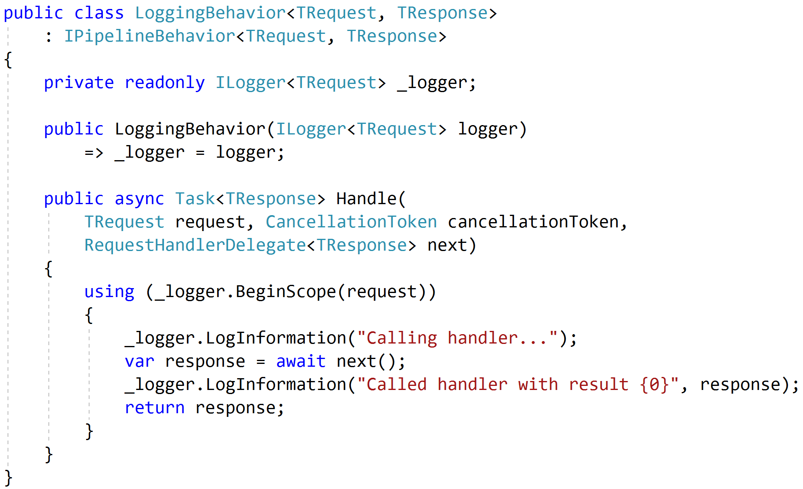
Logging

Slide 77
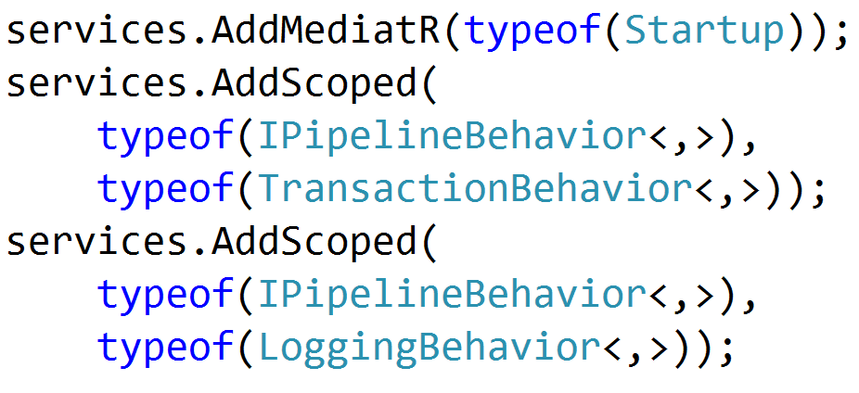

Registration

Slide 78
Testing
Pipeline Behavior
Pipeline Behavior
Pipeline Behavior
Request
Handler
Response
Arrange
Assert
Act

Slide 79
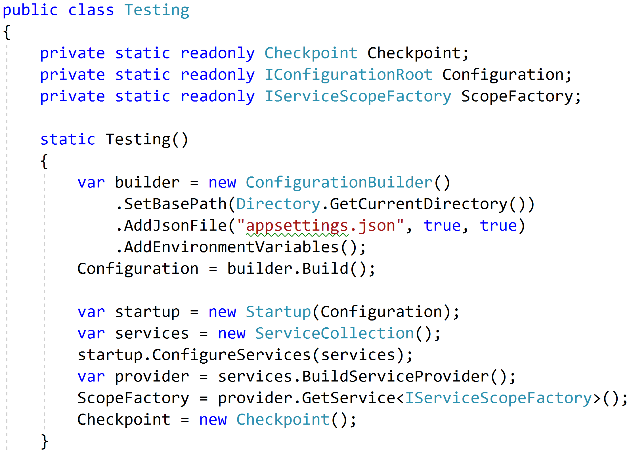
Reproduce Reality

Slide 80
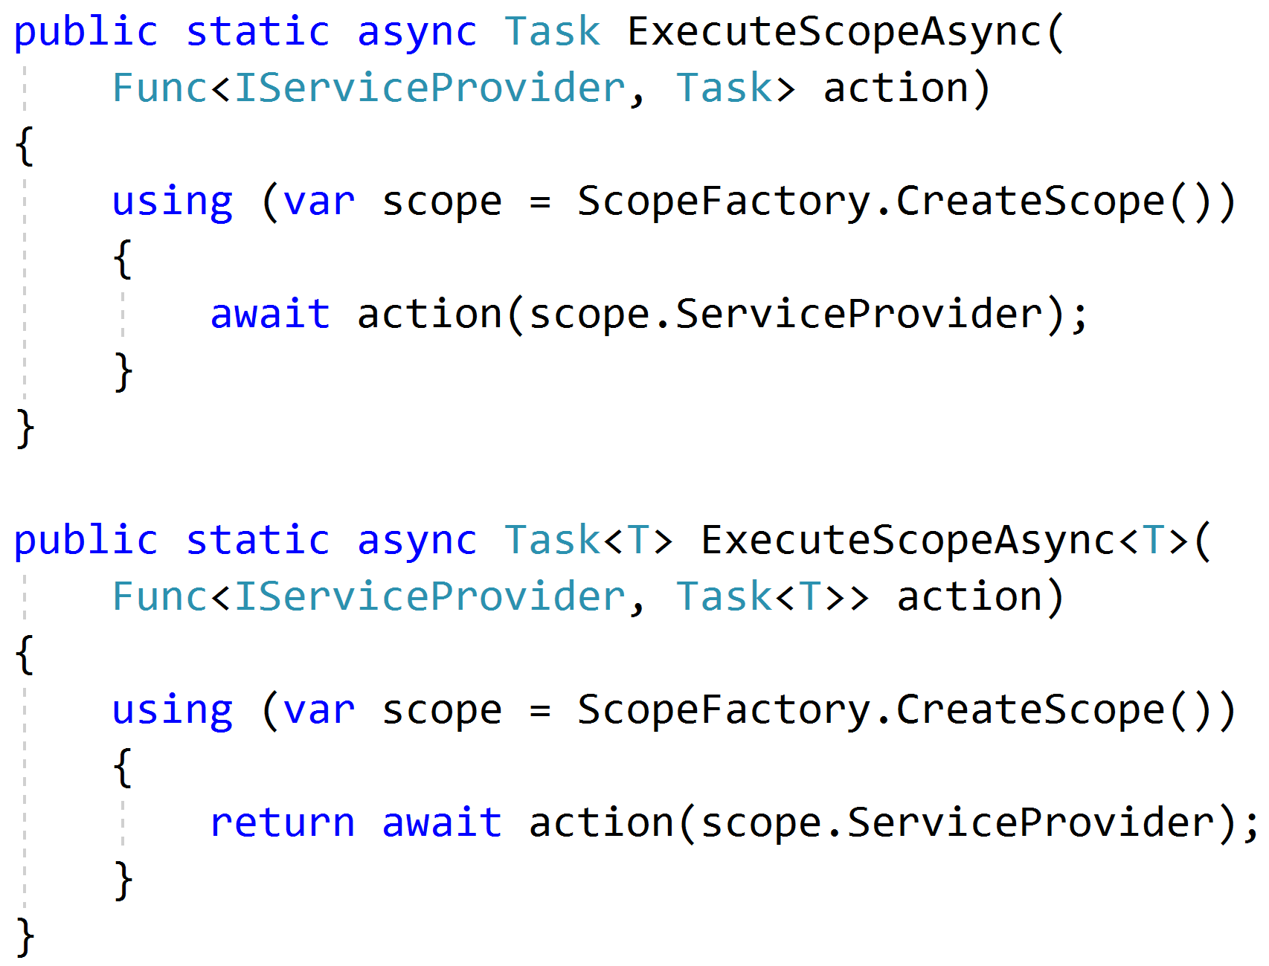
Mimicking Scoped Requests

Slide 81
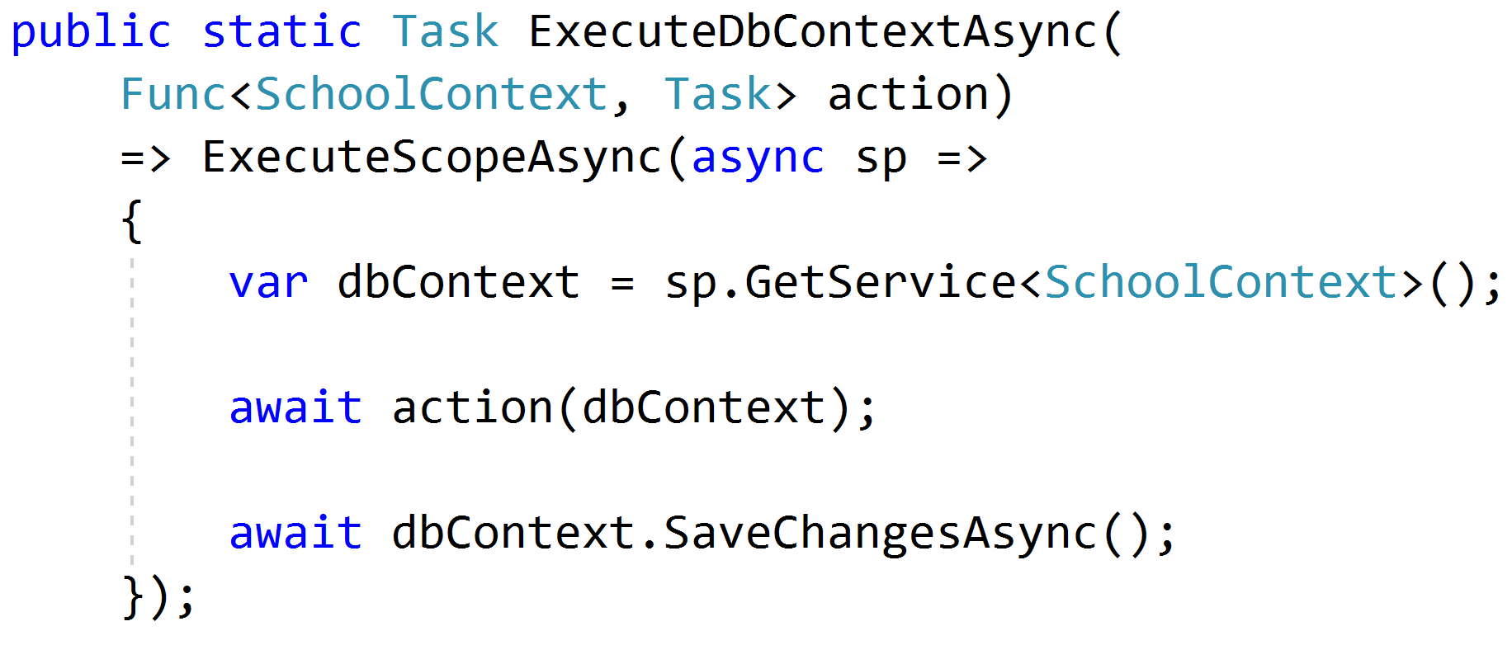
Setting Up Data

Slide 82
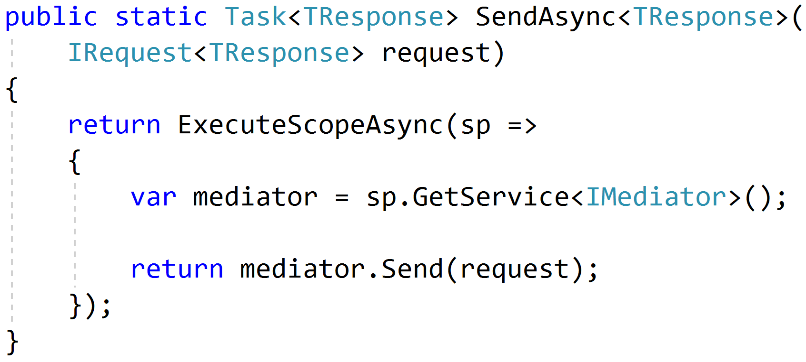
Sending Requests

Slide 83
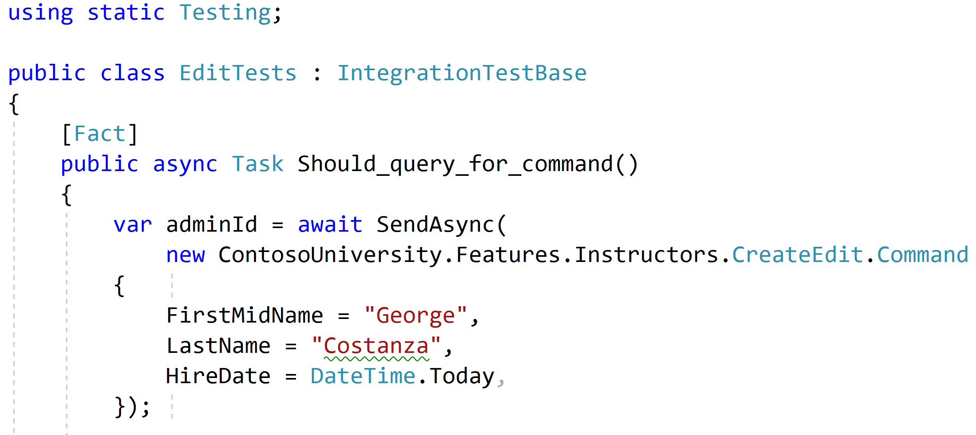
Using static helpers

Slide 84
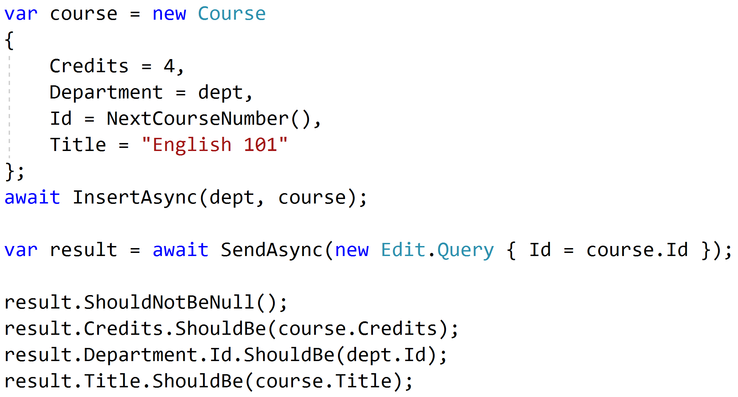
Testing queries through result

Slide 85
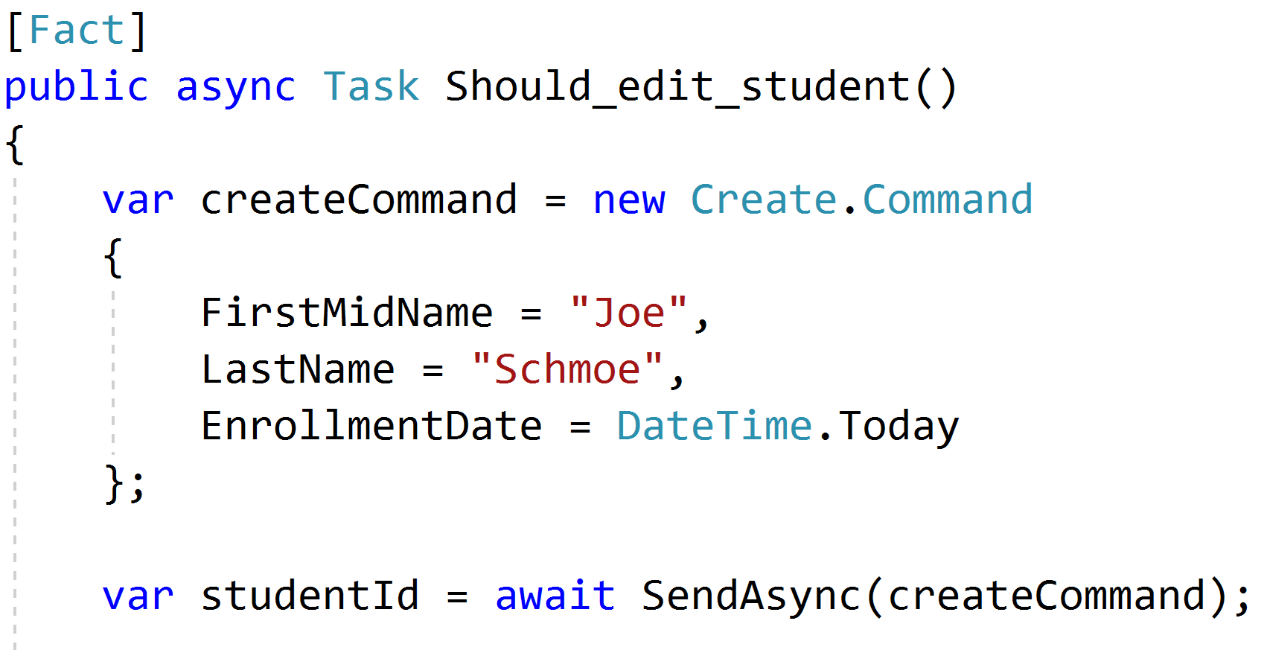
Setup through the front door

Slide 86
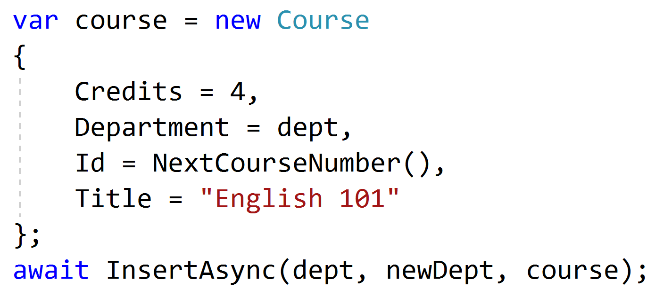
Setup data directly when needed

Slide 87
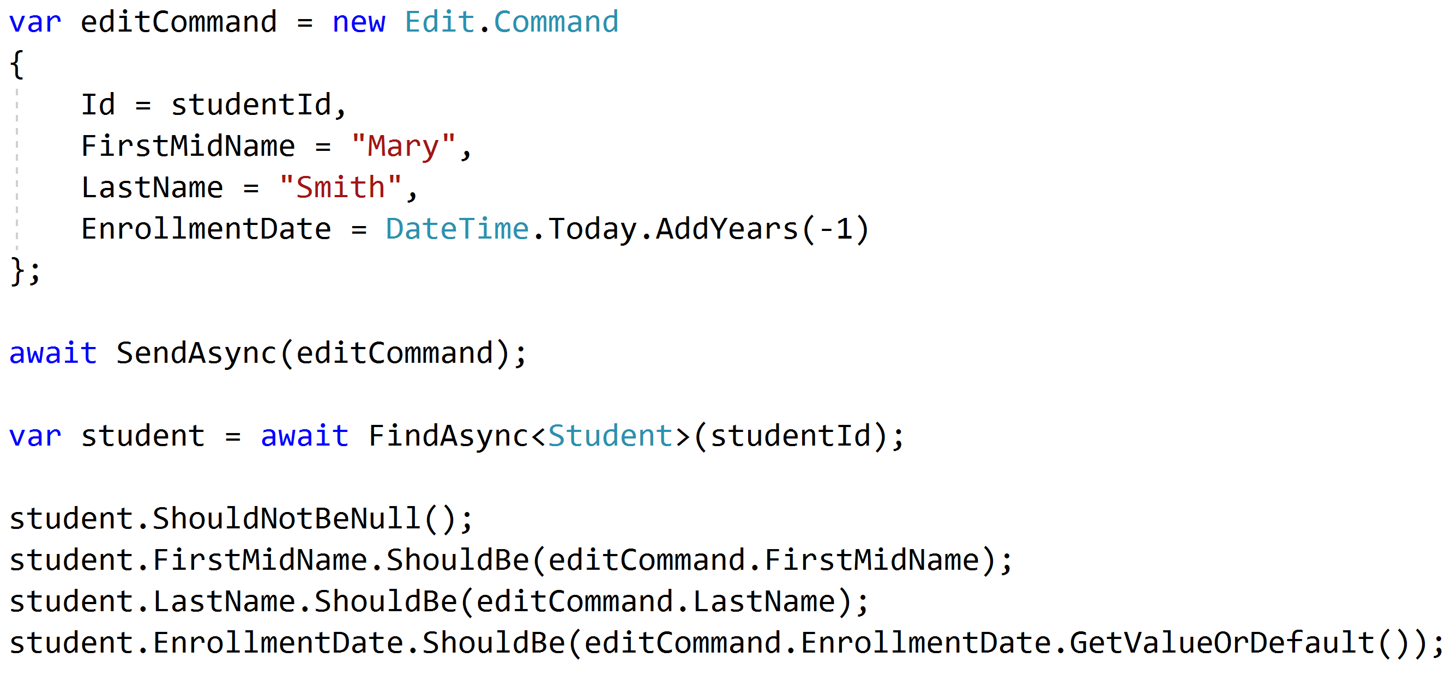
Test commands with roundtrips

Slide 88
Unit and Integration Tests
Pipeline Behavior
Integration Tests
Pipeline Behavior
Pipeline Behavior
Handler
Rich Domain Model
Unit Tests

Slide 89
Key Takeaways
Vertical slices makes code easy to add/change/delete
Do not skip refactor!
Push behavior down
Integration test handlers, unit test domain

Slide 90

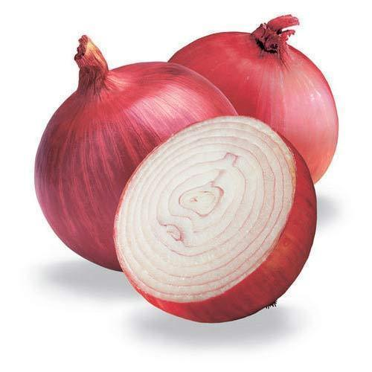
Vertical Slice Architecture
Jimmy Bogard
@jbogard
github.com/jbogard/presentations
bit.ly/2tIFoov
jimmybogard.com

